Slide 1

NeuroCure (Brain Tumor Detection Software)
Darin Davis (2262214)
Ryan Netto (2262248)
Tom Jimmy (2262261)
Guide: Prof.Wims Magdalene Mary
MISSION
CHRIST is a nurturing ground for an individual’s holistic development to make effective contribution to the society in a dynamic environment
VISION
Excellence and Service
CORE VALUES
Faith in God | Moral Uprightness Love of Fellow Beings
Social Responsibility | Pursuit of Excellence

Slide 2
ABSTRACT
CHRIST
Deemed to be University
This project focuses on improving the NeuroCure system for brain tumor classification using deep learning. The primary goal is to enhance inference speed and overall model performance for real-time diagnostic support.
We aim to achieve this through model optimization techniques, including backbone architecture upgrades and accelerated deployment strategies.
The enhanced system will provide faster, more accurate, and explainable predictions, crucial for medical applications.

Slide 3
PROBLEM STATEMENT
CHRIST
Deemed to be University
Problem Statement:
Existing deep learning models for brain tumor classification, while accurate, often suffer from high inference latency, hindering their practical deployment in clinical situations.
The NeuroCure project seeks to address this by optimizing model performance and inference speed, without compromising accuracy.

Slide 4
OBJECTIVE
CHRIST
Deemed to be University
To replace the current CNN backbone (e.g., ResNet) with more efficient architectures (e.g., EfficientNetV2 or MobileNetV3) to improve accuracy-per-FLOP and inference speed.
To implement post-training quantization (float16 or int8) using TensorFlow Lite or ONNX to reduce model size and accelerate inference, especially on edge devices.
To deploy the optimized model using a fast inference stack (e.g., FastAPI with TF Serving/ONNX Runtime Server, containerized with Docker) for real-time performance.
To integrate explainability techniques (e.g., Grad-CAM) to provide visual interpretations of model predictions, enhancing trust and understanding for medical professionals.

Slide 5

BACKGROUND STUDY
S.NO​ | PAPER DETAILS​ | YEAR | FINDING | RESEARCH GAP
1 | Name: Artificial Intelligence (AI) for Brain Tumor Detection: Automating MRI Image Analysis for Enhanced Accuracy Authors: Sagar Bharat Shah Publisher: International Journal of Current Engineering and Technology | 2024 | • The InceptionV3 model achieved over 97% accuracy in brain tumor classification using MRI images. •Data augmentation and preprocessing significantly improved model performance and robustness. • InceptionV3 outperformed VGG19, DenseNet, and standard CNNs on the same dataset. | • No testing on real clinical MRI data. • Tumor segmentation not addressed. • Lacks explainable AI methods. • Patient info not used in prediction.

Slide 6
CHRIST
Deemed to be University
S.NO​ | PAPER DETAILS​ | YEAR | FINDING | RESEARCH GAP
2 | Name: Artificial Intelligence (AI): Brain Tumor Detection Authors: Ms. Mahadevi Pundlik Khyade Publisher: International Journal for Research in Applied Science and Engineering Technology | 2024 | AI can detect and classify brain tumors from scans. CNNs perform better than traditional ML models. Transfer learning boosts accuracy with less data. AI helps in tumor detection, segmentation, and tracking. | Lack of large, labeled medical datasets. Models don’t generalize well across hospitals. AI decisions are hard to interpret. Real-time clinical use is still limited.

Slide 7
S.NO​ | PAPER DETAILS​ | YEAR | FINDING | RESEARCH GAP
3 | Name: An Improved AI Inspired Brain Tumor Detection Authors: Saqlain Razzaq, Muhammad Adeel Asghar, Muhammad Jamil Khan Publisher: ComTech | 2021 | Ensemble of deep features and stacking classifiers enhanced tumor classification accuracy. The model leveraged pretrained CNNs to extract robust MRI image features. Feature fusion improved discrimination between tumor types. Stacking approach outperformed single-model classifiers in detection performance. | Evaluation was limited to public datasets, lacking validation on real clinical scans. Tumor segmentation and localization were not part of the study. Model interpretability methods were not incorporated. The framework’s applicability to multi-institutional settings remains untested.

Slide 8
S.NO​ | PAPER DETAILS​ | YEAR | FINDING | RESEARCH GAP
4 | Name: Optimizing MRI-based brain tumor classification and detection using AI Authors: A. Anaya-Isaza, Leonel Mera-Jiménez, Lucía Verdugo-Alejo, Luis Sarasti Publisher: European Journal of Radiology Open | 2023 | InceptionResNetV2 gave 97%+ accuracy. Transfer learning improved results by ~6%. FLAIR MRI was most effective. Cross‑Transformer trained faster with 90% accuracy. | Only 3 tumor types were tested. No tumor segmentation done. No real hospital data used. Lacked model explainability.

Slide 9
S.NO​ | PAPER DETAILS​ | YEAR | FINDING | RESEARCH GAP
5 | Name: Brain Tumor Identification and Classification Using Enhanced Convolution Neural Network Author: J. Raju, Krteen Anand, D. Krishna Kumar, D. Sivaganesan Publisher: 5th International Conference on Inventive Research in Computing Applications (ICIRCA) | 2023 | CNN 7×7 model outperformed pretrained CNNs in tumor classification. Pretrained models (DenseNet‑201, ResNet‑101, SqueezeNet) boosted feature extraction. Random cropping enhanced training accuracy via data augmentation. Automated system beat manual diagnosis in speed and accuracy. | Tested only on public datasets, not clinical data Tumor segmentation/localization was not included. No focus on explaining AI model decisions. Unknown performance across different hospitals or scanners.

Slide 10
METHODOLOGY
CHRIST
Deemed to be University
1. Requirement Analysis
Stakeholder Interviews: Consulted with medical professionals and ML engineers to understand diagnostic workflow and pain points in real-time MRI analysis.
Data Flow Analysis: Designed workflows for uploading MRI scans → preprocessing → prediction → heatmap explanation → logging results.
Tech Stack Evaluation: Benchmarked TensorFlow, PyTorch, and ONNX for performance; selected EfficientNet + ONNX Runtime for optimal speed and accuracy.
2. System Design
Hybrid Database Architecture:
MongoDB (NoSQL): Store scan logs, model inferences, and patient metadata.
PostgreSQL (SQL): Manage structured records like doctor-patient mappings and audit trails.
FastAPI (Python): Expose tumor classification via asynchronous REST endpoints.
Microservices: Deploy AI inference as a Dockerized FastAPI container for modular and scalable cloud integration.

Slide 11
METHODOLOGY
CHRIST
Deemed to be University
3. Development
Frontend (React + Material-UI):
Intuitive dashboard for scan upload, inference display, and Grad-CAM heatmap visualization.
Mobile-responsive interface for clinical usability.
Backend (FastAPI + Uvicorn):
Async REST endpoints for classification using ONNX Runtime-accelerated models.
Integrated TensorRT support for GPU acceleration.
Database Integration:
MongoDB Atlas: Store inferences, timestamps, Grad-CAM maps, and diagnostic notes.
PostgreSQL RDS: Handle hospital/doctor mappings, user management, and event logs.
4. AI/ML Integration
Model Backbone: EfficientNetB0 trained on labeled MRI datasets with augmentation.
Model Optimization: Converted to ONNX and optimized via TensorRT; quantized with TFLite for edge devices.
Explainability: Grad-CAM added using tf-keras-vis for visual interpretability of tumor areas.
Containerization: Model wrapped in Docker for easy deployment across cloud services.

Slide 12
METHODOLOGY
CHRIST
Deemed to be University
5. Testing & Deployment
Testing Strategy:
Pytest: For unit and integration testing of FastAPI endpoints and prediction logic.
Postman: To validate prediction API and Grad-CAM image generation.
Deployment Strategy:
Frontend: Hosted via Vercel or Netlify.
Backend: Deployed using AWS Lambda (serverless) or Google Cloud Run (Dockerized inference).
Databases: MongoDB (Atlas) and PostgreSQL (RDS) with nightly backup policies.

Slide 13
TECHNOLOGY AND TOOLS
CHRIST
Deemed to be University
Hardware Requirements:
GPU-enabled workstation (NVIDIA GPU recommended for TensorRT)
Sufficient RAM (e.g., 16GB+) for model loading and processing
Adequate storage for datasets and models
Software Requirements:
Deep Learning Framework: TensorFlow 2.x (or PyTorch)
Libraries: tf.keras, tensorflow-lite, tf2onnx (or keras2onnx), onnxruntime, nvidia-tensorrt (if using NVIDIA GPUs), fastapi, uvicorn, torchserve or tensorflow-serving-api, tf-keras-vis (for explainability)
Containerization: Docker
Operating System: Linux (Ubuntu recommended) or Windows with WSL2
Python Version: Python 3.8+

Slide 14
PROJECT TIMELINE
CHRIST
Deemed to be University
Month | Tasks
July | Initial setup of development environment (TensorFlow/PyTorch, Docker).
August | Implementation of new CNN backbone (e.g., EfficientNetB0) and transfer learning. Initial training and evaluation of the new backbone
September | Experimentation with Post-Training Quantization (float16, int8) using TensorFlow Lite/ONNX. Performance comparison of quantized models.
October | Development of FastAPI-based inference API. Integration with TF Serving/ONNX Runtime Server

Slide 15
CONCLUSION
CHRIST
Deemed to be University
Current Achievements:
This project outlined a clear strategy to significantly enhance the NeuroCure system's brain tumor classification capabilities, focusing on inference speed and performance.
By proposing the adoption of efficient CNN backbones, post-training quantization, and robust deployment stacks, we aim to overcome the limitations of current deep learning models in clinical settings.
The integration of explainability methods will foster trust and provide crucial insights for medical professionals.
Expected Impact:
The optimized NeuroCure system is expected to deliver faster and more accurate brain tumor diagnoses, contributing to improved patient outcomes.
Reduced inference latency and model size will enable broader deployment, including on resource-constrained edge devices.
The explainable AI component will bridge the gap between complex AI decisions and practical medical understanding.

Slide 16
REFERENCES
CHRIST
Deemed to be University
Artificial Intelligence (AI) for Brain Tumor Detection: Automating MRI Image Analysis for Enhanced Accuracy
Artificial Intelligence (AI): Brain Tumor Detection
An Improved AI Inspired Brain Tumor Detection
Optimizing MRI-based brain tumor classification and detection using AI
Brain Tumor Identification and Classification Using Enhanced Convolution Neural Network

Slide 17
Phase 2
Implementation Details

Slide 18
OVERVIEW
Phase 2 of the NeuroCure project builds upon the successful completion of Phase 1, where a functional and optimized brain tumor classification system was developed.
This phase focuses on enhancing explainability, improving diagnostic accuracy, and optimizing system performance for deployment on low-end and CPU-only systems.
The goal is to move closer to a clinically deployable, efficient, and trustworthy AI-based diagnostic tool.

Slide 19
OBJECTIVES
The primary objectives of Phase 2 are as follows:
To integrate explainable AI techniques such as Grad-CAM to visually interpret model predictions.
To improve the overall accuracy and robustness of the brain tumor classification model.
To optimize the system for low-end hardware and CPU-only environments.
To reduce inference latency and enable faster prediction times for real-time usage.
To enhance the system’s usability and reliability in practical clinical settings.

Slide 20
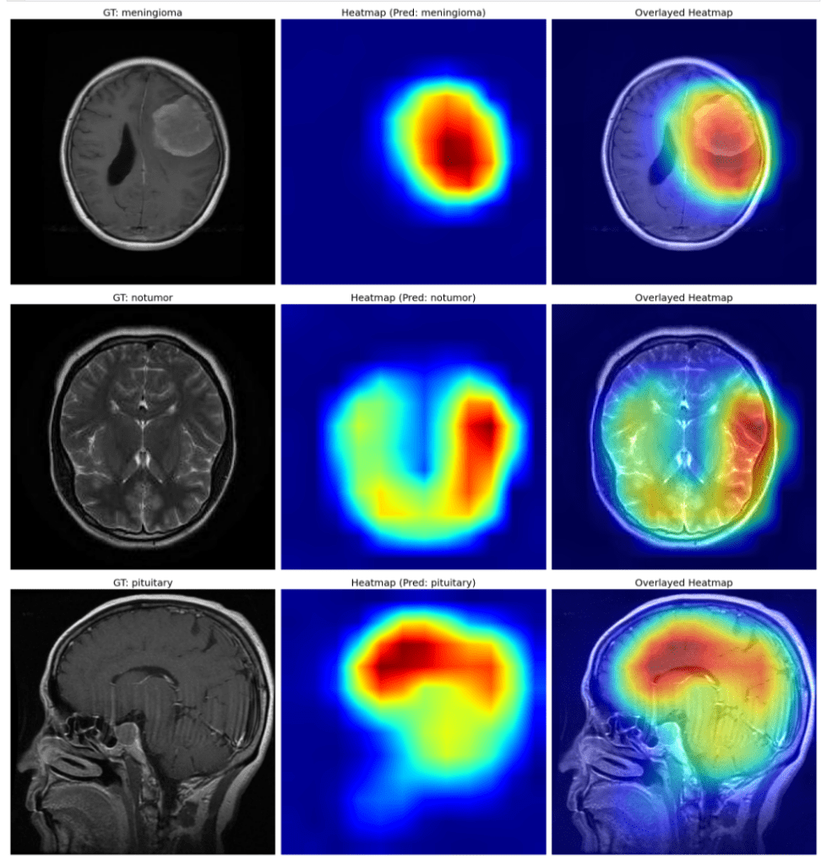
GRAD-CAM ENABLEMENT
To enhance transparency and trust in the AI system, Phase 2 introduces the integration of Gradient-weighted Class Activation Mapping (Grad-CAM). Grad-CAM generates visual heatmaps that highlight the regions of MRI scans influencing the model’s predictions.
This enables medical professionals to better understand and validate AI-driven decisions, thereby bridging the gap between deep learning outputs and clinical interpretation.

Slide 21
ACCURACY & OPTIMIZATION
Phase 2 emphasizes improving diagnostic accuracy without increasing computational complexity. This includes fine-tuning the EfficientNet backbone using improved data augmentation techniques, class balancing strategies, and hyperparameter optimization. Additional evaluation metrics such as precision, recall, F1-score, and confusion matrices will be used to ensure consistent and reliable performance across all tumor classes.
To ensure broader accessibility, the system will be optimized to function efficiently on low-end hardware and CPU-only systems. Techniques such as post-training quantization (INT8 and FP16), ONNX Runtime CPU optimizations, and memory footprint reduction will be employed. These optimizations allow deployment in resource-constrained environments such as small clinics and diagnostic centers without dedicated GPUs.

Slide 22
TIMELINE
Month | Tasks
January | Research and implementation of Grad-CAM Accuracy improvement experiments Dataset refinement and validation
February | Model quantization and CPU optimization ONNX Runtime benchmarking Performance evaluation on low-end systems
March | Final system integration , UI enhancements for Grad-CAM visualization ,Testing, documentation, and final evaluation

Slide 23
THANK YOU

